Slide 1
Digital System
Design
Dr. Nazanin Ghasemian
Fall 2026 · Lecture 6

Slide 2
Last Lecture
FSM design
Mealy and Moore machines
State diagram and state tables

Slide 3
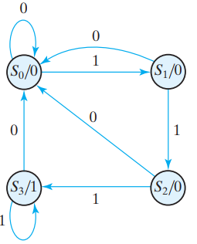
Design Example
Suppose we wish to design a circuit that detects a sequence of three or more consecutive 1’s in a string of bits coming through an input line.
Notes:
This is a moore machine

Slide 4
Design Example
Two ways to design the circuit:
  Using HDL + synthesis tools: Write an HDL description of the state diagram and use tools to generate the netlist.
  By hand: Assign binary codes to the states and create the state table.

Slide 5
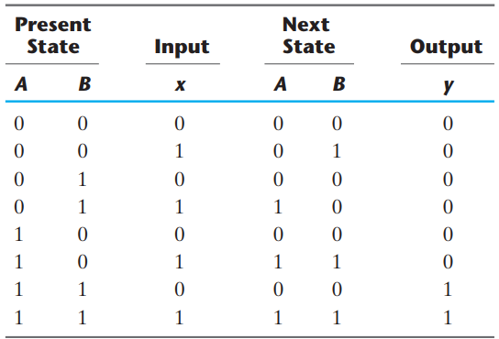
Design Example
State Diagram
State Table

Slide 6

Design Example-D Flip-flop
We choose two D flip-flops to represent the four states, and we label their outputs A and B.
The characteristic equation of the D flip-flop is $Q(t + 1) = D_{Q}$.

Slide 7
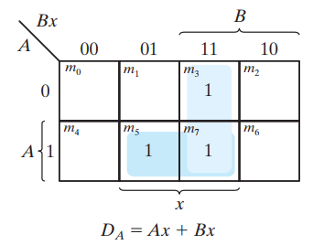
Design Example-D Flip-flop
State Table

Slide 8
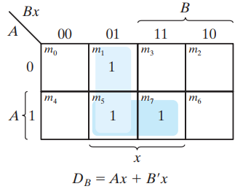
Design Example-D Flip-flop
State Table

Slide 9
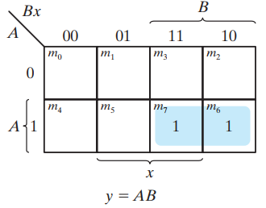
Design Example-D Flip-flop
State Table

Slide 10
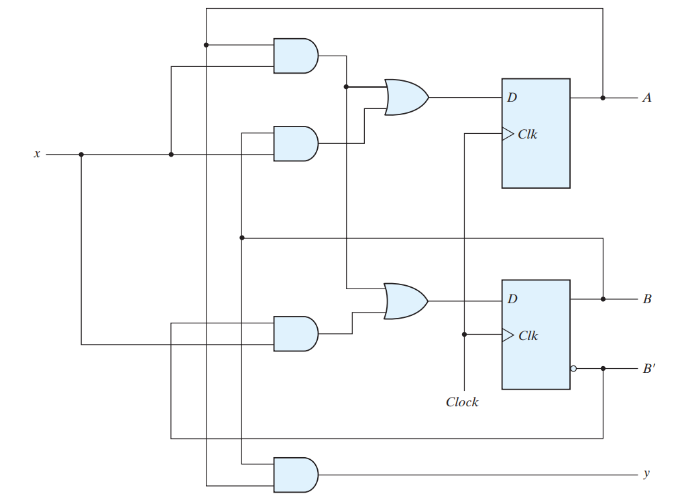
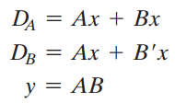
Design Example-D Flip-flop

Slide 11
Design a State Machine
When using a simulator or synthesizer, we only need to describe the behavior of our circuit.
We don’t have to worry about:
  how many flip-flops will be used in the final design,
  which type of flip-flop to use,
  or how the input and output connections to the flip-flop will be implemented.

Slide 12
Design a State Machine - SystemVerilog
Let’s design our example using SystemVerilog.
A circuit that detects a sequence of three or more consecutive 1s.
In_bit
detect

Slide 13
Design a State Machine - SystemVerilog
We add a clock (clk) to our design:
  The detector needs to look at the input one bit at a time, like a stream of data arriving in sequence.
  A clock provides this timing — at each rising edge of the clock, the circuit checks the next input bit and updates its state.
  Without a clock, the circuit would not know when to move from “I’ve seen one 1” → “I’ve seen two 1s” → “I’ve seen three 1s.”

Slide 14
Design a State Machine - SystemVerilog
We add a reset signal to our design:
  Reset is used to start the circuit in a known state when we power on or begin a simulation.
  For our detector, we want it to begin in the state “no 1s seen yet.”
  If we don’t include reset, the circuit might start in a random state, leading to incorrect behavior right from the beginning.

Slide 15
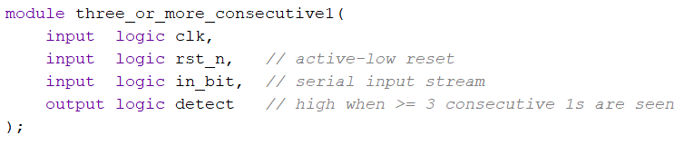
Design a State Machine - SystemVerilog
Module declaration:
In_bit
detect
Clk
rst_n
Notes:
Historical / Hardware reason:
Many physical chips and flip-flops are designed with active-low reset pins because it is easier and more reliable in hardware to force signals to zero (ground) than to one (power).
Active-low signals are less sensitive to electrical noise in some cases.
Convention:
Since so many devices use active-low reset, it became an industry standard.
Adding the _n (or sometimes _b for “bar”) in the name makes it clear to readers that this reset is active when low.

Slide 16
Design a State Machine - SystemVerilog
We need to define some states for our circuit.
In this case, there are 4 states, so we need 2 bits to represent them:
What we really need to keep track of is the current state of the circuit.
00 → S0 01 → S1 | 10 → S2 11 → S3
Based on the current state and the circuit’s input, we then decide what the next state should be.

Slide 17
Design a State Machine - SystemVerilog
We need two bits to represent the current state.
What should its type be?
  The possible values we want to assign are S0, S1, S2, and S3.
One good way to define the current state is to create our own type using typedef along with enum. This makes the code easier to read and understand, since we can work with state names instead of raw binary values.

Slide 18
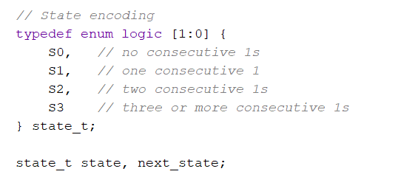
Design a State Machine - SystemVerilog
In this code, I defined a new type called state_t.
What is state_t?
  It is an enumeration (enum) that uses 2 bits of logic to represent the states: S0, S1, S2, and S3.

Slide 19
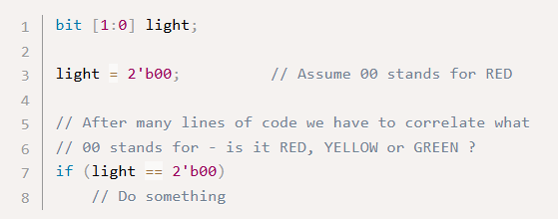
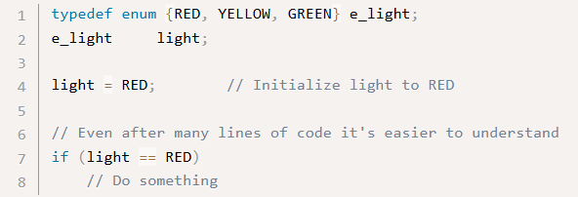
Enumerated type
An enumerated type defines a set of named values.
Why do we need enumeration?
  To make the code simpler and more readable.
Consider the following example.

Slide 20
Typedef
In SystemVerilog, the typedef keyword is used to create custom data types or aliases for existing data types.
This feature enhances code readability, maintainability, and reusability, especially when dealing with complex data structures.

Slide 21
Design a State Machine - SystemVerilog
Now, to define the behavior of our circuit and generate the output (detect), we need two things:
Updating the state of the machine
Producing the output

Slide 22
Design a State Machine - SystemVerilog
Now, to define the behavior of our circuit and generate the output (detect), we need two things:
Updating the state of the machine
  The current state must be stored somewhere, so we use memory elements (two flip-flops) to record it.
  At each clock cycle, the flip-flops update the current state (state) with the new value, called the next state.
  Later, we will decide how to assign values to this next_state variable.

Slide 23
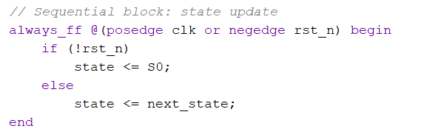
Design a State Machine - SystemVerilog
Now, to define the behavior of our circuit and generate the output (detect), we need two things:
Updating the state of the machine

Slide 24
Design a State Machine - SystemVerilog
Now, to define the behavior of our circuit and generate the output (detect), we need two things:
Updating the state of the machine
Producing the output
  The output detect will depend on the current state.

Slide 25

Design a State Machine - SystemVerilog
Now, to define the behavior of our circuit and generate the output (detect), we need two things:
Updating the state of the machine
Producing the output

Slide 26
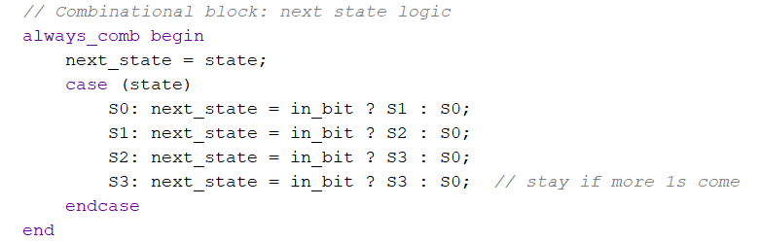
Design a State Machine - SystemVerilog
For the next state we can follow the state diagram and use Case statement.

Slide 27
Case Statement
The case statement checks if the given expression matches one of the other expressions in the list and branches accordingly.
It is typically used to implement a multiplexer.
The if-else construct may not be suitable if there are many conditions to be checked.

Slide 28
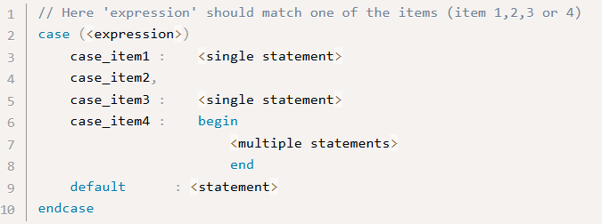
Case Statement
case statement starts with the case keyword and ends with the endcase keyword.

Slide 29
Case Statement
The expression within parentheses will be evaluated exactly once and is compared with the list of alternatives in the order they are written and the statements for which the alternative matches the given expression are executed.
Notes:
A block of multiple statements must be grouped and be within begin and end.

Slide 30
Case Statement
If none of the case items match the given expression, statements within the default item is executed. The default statement is optional.
Notes:
Execution will exit the case block without doing anything if none of the items match the expression and a default statement is not given.

Slide 31
Case Statement
A case statement must always be placed inside a procedural block.

Slide 32
Design a State Machine - SystemVerilog
Conditional (ternary) operator
  y = (condition) ? value_if_true : value_if_false;

